Slide 1
Big data analytics
6.
2020

Slide 2
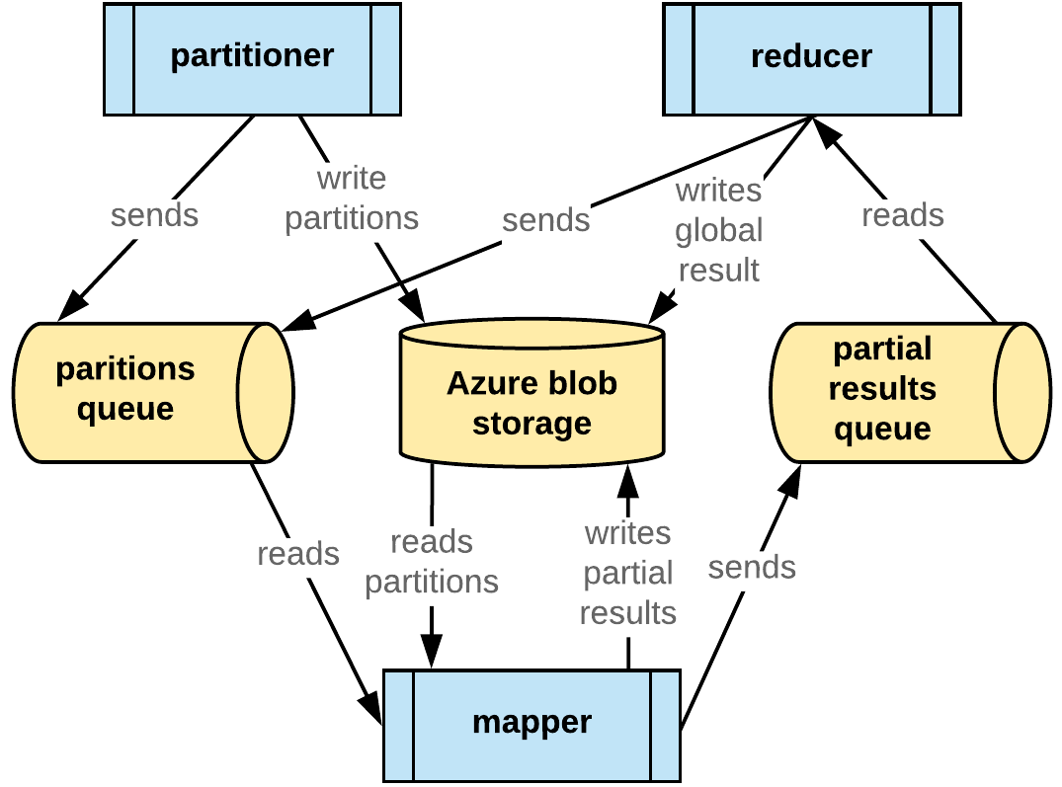
DISTRIBUTED PLATFORM
Analyze Documents/Platform.doc

